Slide 1
Voice your Vote
Lesson #3: Mock Election

Slide 2
Lesson Resources
1
2
3
Essential Question
Connect
Resources
Skill Video:
Vote Responsibly
Review the lesson objective as you discuss the essential question.
Explore digital resources that support building connections to the content.
Teach civic skills brought to you from Civics Interactive!
4
5
6
Reading Passage:
Voting Matters
Active Classroom Strategies
Civic Skill Lesson:
Vote Responsibly
Teach civic skills brought to you from Civics Interactive!
Quick strategies to spark conversation, build background knowledge and active student engagement.
Use the lesson slides to teach essential civic skills with “Take Action” slides to put the skills to practice.

Slide 3
Essential Question
Why is it important to vote?

Slide 4
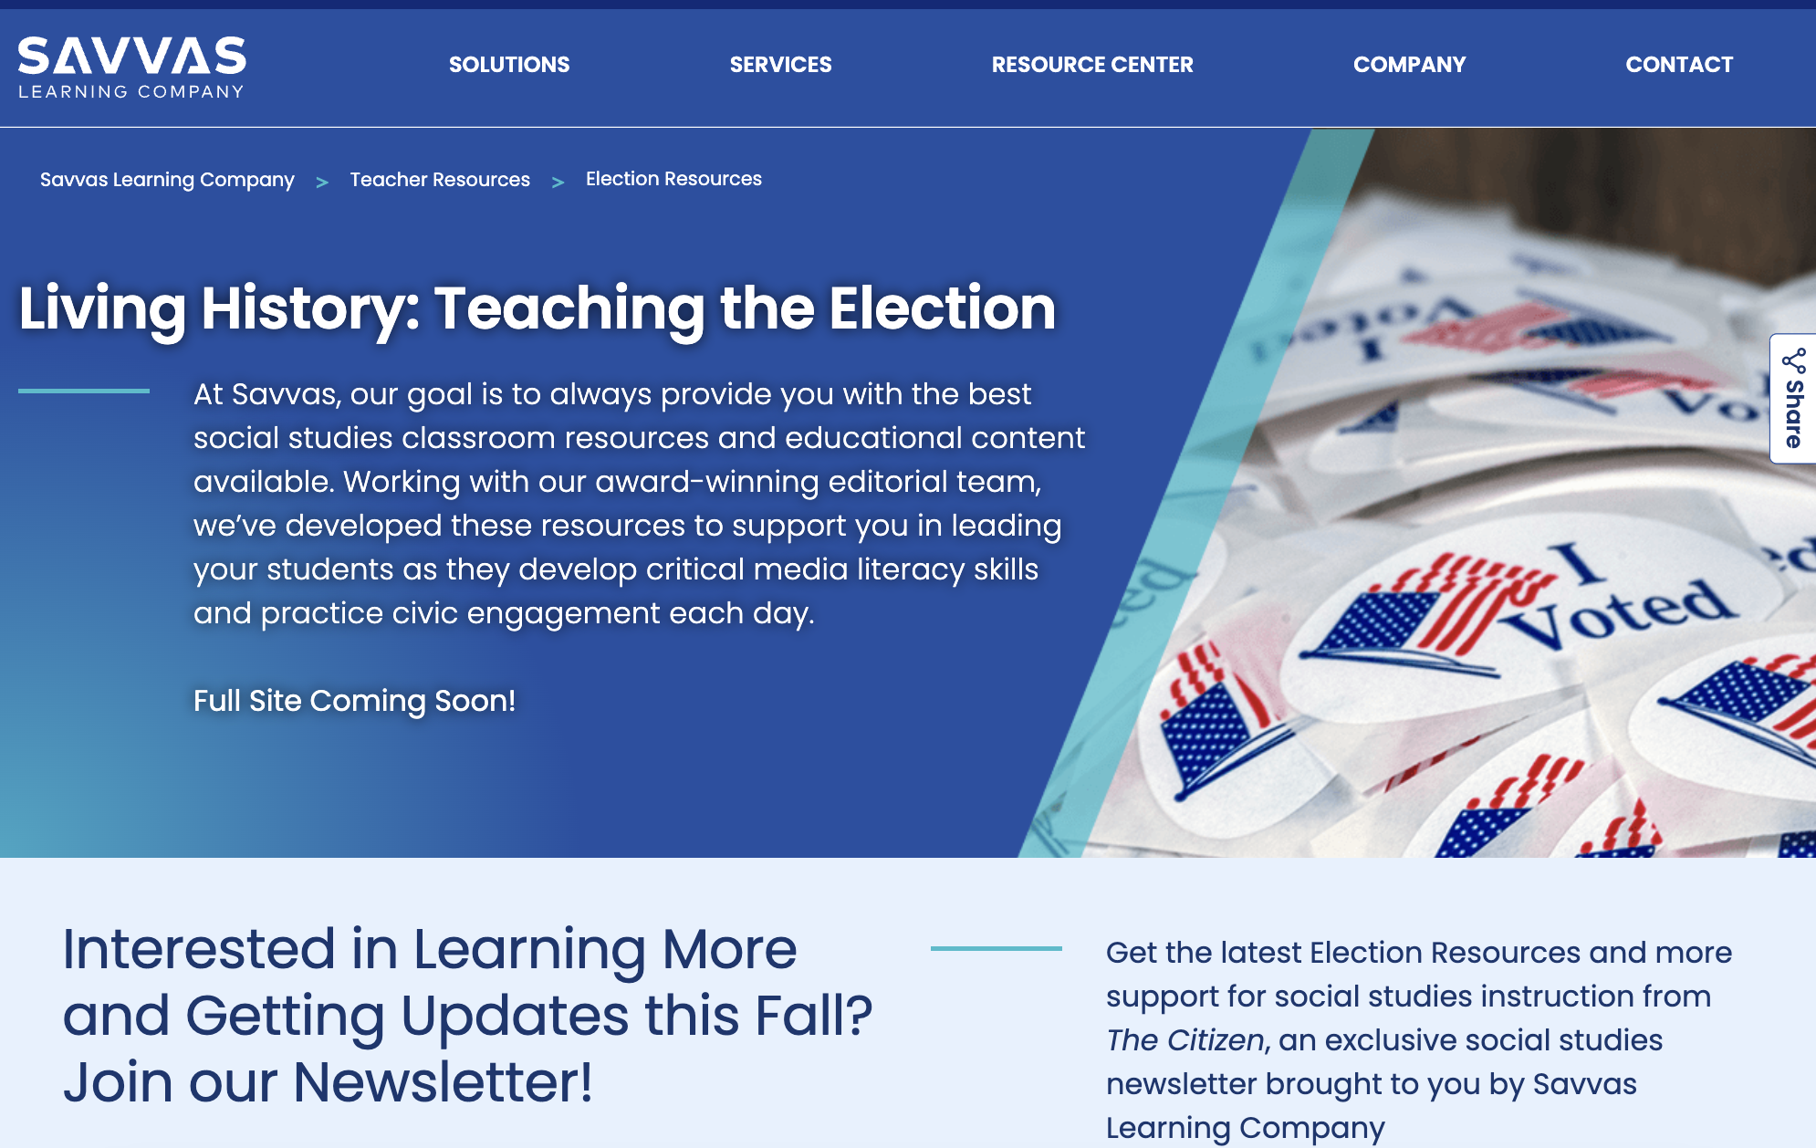
Connect students to content on savvas.com/election
Voices & Views
Civics Education
Connections to Today
Voter Participation

Slide 5
Skill Video: Vote Responsibly

Slide 6
Reading Passage:
Voting Matters

Slide 7
Quick Write
What are some things you have voted for?
Notes:
Teacher Notes:
Suggested strategy for classrooms grades K-2
Ask students to write what they know about a key idea or term in 30 seconds.

Slide 8
My Metaphor
Voting is like _________ because _________ .
Notes:
Teacher Notes:
Suggested strategy for classrooms grades 3-5
Ask students to fill in the metaphor prompt to help explain their perspective and understanding.

Slide 9
Circle Write
Why is it important to vote?
Notes:
Teacher Notes:
Suggested strategy for classrooms grades 6-8
Break into groups and provide a writing prompt or key question.
Have students write as much as they can in response to the question or prompt for one minute.
Next have students give their response to the person on their right. That person should improve or elaborate on the response where the other person left off.
Continue to pass each response to the right until the original response comes back to the first person.
Each group then reviews all the responses and decides which is the best composition and shares that with the larger group.

Slide 10
Graffiti Concepts
What are some reasons to vote?
Notes:
Teacher Notes:
Suggested strategy for classrooms grades 9-12
﻿﻿Ask students to reflect on the meaning of a concept or idea and create a visual image and/or written phrase that represents that concept. Allow approximately three to five minutes.
﻿﻿Next ask students to post their "graffiti" on the board or on chart paper and ask students to look at all the various responses.
﻿﻿Next discuss similarities and differences in the responses as a group.

Slide 11
Civic Skill Instruction
Cast your Ballot

Slide 12
Voting Matters
OBJECTIVES
Learn more about voting responsibly by casting your ballot.
Recognize the importance of voting in a democratic society.
Understand the qualifications for voting and how to register to vote.
Analyze some issues about voting today.
Notes:
Teaching Suggestions
The slides in this presentation walk students through the key elements of the Savvas lesson, with Teaching Suggestion notes available in presenter view. The slides are fully customizable for you to add and/or subtract to make the lesson your own. You can delete slides you know you won’t want to use, mark slides to be skipped so they won’t be seen, or add slides to incorporate your own favorite assets. The teaching suggestions are also fully editable.
The slides that follow each identify which objective is addressed.
Differentiated Instruction
Use these strategies to provide additional support or review for students after they do the Exit Ticket.
Special Needs Help students to understand the voting process. Prepare slips of paper with the following steps in the voting process: Register, Research candidates, Plan your trip, Read ballot instructions, and Cast your vote. Discuss the meaning of each step with students, and then have them sort the slips of paper into proper order and paste them into their notebooks.
Extra Support After reading the whole text, work together with students to describe the voting process.You may wish to have students complete a list using the sequence terms first, next, after that, and finally.
Challenge/Gifted Have students select another country, state, or community and investigate the voting laws there. They may be interested in a country without a two-party system, such as Argentina, the Netherlands, or Uganda. Encourage them to reflect on the differences between that system and the U.S. system. Ask: How do they compare?

Slide 13
Why Vote?
Q: Why should anyone vote?
ensure quality politicians
Reasons to Vote
Notes:
Teaching Suggestions
Learning Objective: Recognize the importance of voting in a democratic society.
Direct students to the Lesson Skills Note-taking Sheet, which they can use as they read the Student Text.
Discuss reasons people should vote when they are able. Call on students to help complete the chart. (Answers will vary but may include: to reflect public opinion and emphasize values, to hold politicians accountable, your vote can make a difference, your vote sends a message, foundation of democracy, responsibility as a citizen.)

Slide 14
The Voting Process
Qualifications for Voting
Who? | Generally speaking, you must be 18 or older and a citizen. You must also typically be a resident of the state in which you will vote. Some individuals convicted of crimes lose the right to vote.
How? | You must first register to vote. Each state has its own laws including how far in advance of an election you must be registered.
What? | You don’t have to be informed but it is very important! You should know what offices are up for election, the candidates and their stances, and anything else on the ballot.
When? | Each election has their own days to vote, but the Federal Election day occurs on the Tuesday after the first Monday in November.
Where? | You must locate your polling location or vote by mail.
Q: Do these qualifications seem appropriate to you? Why or why not?
Notes:
Teaching Suggestions
Learning Objective: Understand the qualifications for voting and how to register to vote.
Talk through the qualifications for voting. Where possible, give students specific information based upon your location. For example, if you know of the community’s polling locations, you may share those as examples. If you know your states’ registration requirements, you may share those.
Ask: Do these qualifications seem appropriate to you? Why or why not?

Slide 15
What Issues Can Arise in the Voting Process?
the winning candidate takes the position
One candidate concedes, the other accepts the victory
courts determine whether there was voter fraud
a recount occurs and the rightful victor is proclaimed
Citizens vote and votes are counted
states create new voting laws to ensure secure elections
One candidate requests a recount
a recount occurs and the losing candidate claims voter fraud
in some places, this made it harder to vote
Notes:
Teaching Suggestions
Learning Objective: Analyze some issues about voting today.
Walk students through the flowchart. Emphasize that the vast, vast majority of elections follow the uppermost path, and that our government relies on peaceful transitions of power.
You may wish to reference some controversies students may be familiar with such as former president Donald Trump’s unfounded accusations of voter fraud.

Slide 16
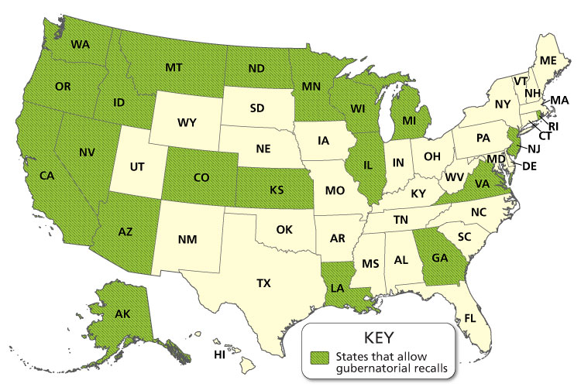
Analyze a Map
Notes:
Teaching Suggestions
Learning Objective: Understand how the winners of elections are determined and how the Electoral College works.
Tell students that this map shows the states that allow gubernatorial recalls.
Ask: Does our state allow gubernatorial recalls? (Answer should reflect the map.) What percent of states would you estimate allow recalls? (40 percent) Are you surprised by this number? Do you think more states should have this option? Why or why not? (Answers will vary but students should use reasons with their response.)

Slide 17
Voting Simulation
Make a note of your assigned political party.
Work with your groupmates to research and create a candidate to represent your party.
Then, present your candidate and listen to your classmates’ candidates.
Vote!
Reflect and debrief with your class.
Notes:
Teaching Suggestions
Students enhance their understanding of how to vote responsibly by practicing casting a ballot. The Act On It Activity Sheet includes space for students to plan for the election and a tear-off area to use as a ballot.
Divide the class into two to four groups and assign each group a political party. You may opt to create fictional or use historical political parties, or you may not in order to make students potentially less “loyal” to their created cadidate. Have each group work together to research and create a candidate that will represent their party. Then have them present their candidates and place their names on the ballot.
Before conducting the vote, briefly remind students how to cast a ballot.
Research Your Options What will be on the ballot? Who is running for office? Use your skills to distinguish their party and analyze their political ads.
Plan Your Trip Where is your polling place? How will you get there? When will you go?
Read the Ballot Instructions Once you arrive at your polling location and have received your ballot, read the instructions. If you have any questions, poll workers are knowledgeable and there to help.
Cast Your Vote Make your selections and follow the instructions to submit your ballot.
Using folders to create privacy screens, have students complete their ballots. You may wish to have them place them in a box or you may collect them and tally the votes. Share results with students. Ask: Are you satisfied with the results? Why or why not?
Pressed for Time? Instead of having students research, create, and vote on their own candidates, present them with fictionalized candidates to place on the ballot.

Slide 18
Voting
Write down the steps you will take when it comes time for you to register and vote.
Notes:
Teaching Suggestions
Have students write the steps they will take to register and vote.
Differentiated Instruction
If the Exit Ticket shows that some students still struggle with this lesson, you may want to assign the Lesson Summary as remediation. Give students the Lesson Summary, which is written two levels below grade level, to help students review key concepts

Slide 19
Take Action
Reasons to Vote
Notes:
Teaching Suggestions
SKILL: SPREAD THE WORD ABOUT VOTING
Have students use the skill of casting a ballot in the Take Action activity.
First, lead a discussion or have students independently brainstorm reasons why it is important to vote. Add student ideas to the list on the board.
Then, with partners, small groups, or individually, have students create posters, infographics, or videos to encourage citizens to register and vote.
Submit student work to the local board of elections or League of Women Voters for possible use.
Debrief as a whole class. Ask: What approach did you take on your piece? Why?
PRESSED FOR TIME? Work together as a class to create a PSA or video in which each student gives one statement. If multiple students would like to make the same statement, allow them to speak in sync.

Slide 20
Explore our K-12 Social Studies Curriculum
savvas.com/socialstudies

