Slide 1
MEdia Literacy Starts with ME!
Lesson #2: Media Literacy & Responsible Voting

Slide 2
Lesson Resources
1
2
3
Essential Question
Connect
Resources
Skill Video:
Find Accurate Information
Review the lesson objective as you discuss the essential question.
Explore digital resources that support building connections to the content.
Teach civic skills brought to you from Civics Interactive!
4
5
6
Reading Passage:
Where do you learn the news?
Active Classroom Strategies
Civic Skill:
Find Accurate Information
Teach civic skills brought to you from Civics Interactive!
Quick strategies to spark conversation, build background knowledge and active student engagement.
Use the lesson slides to teach essential civic skills with “Take Action” slides to put the skills to practice.

Slide 3
Essential Question
How do I vote responsibly?

Slide 4
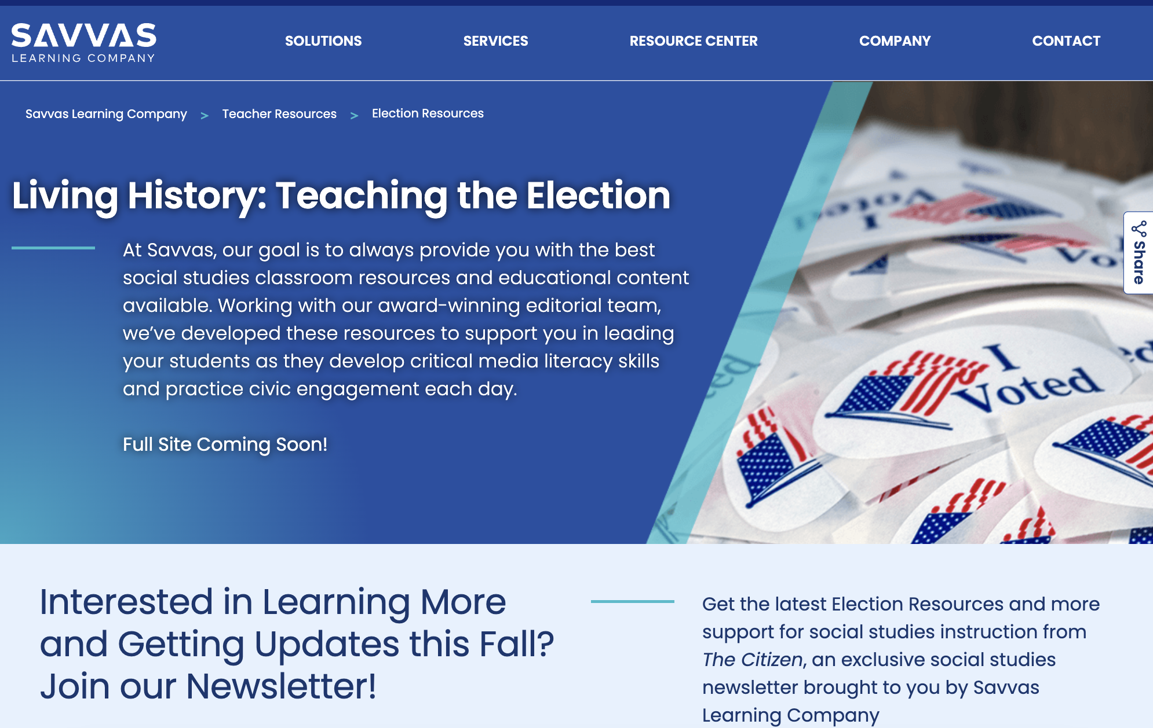
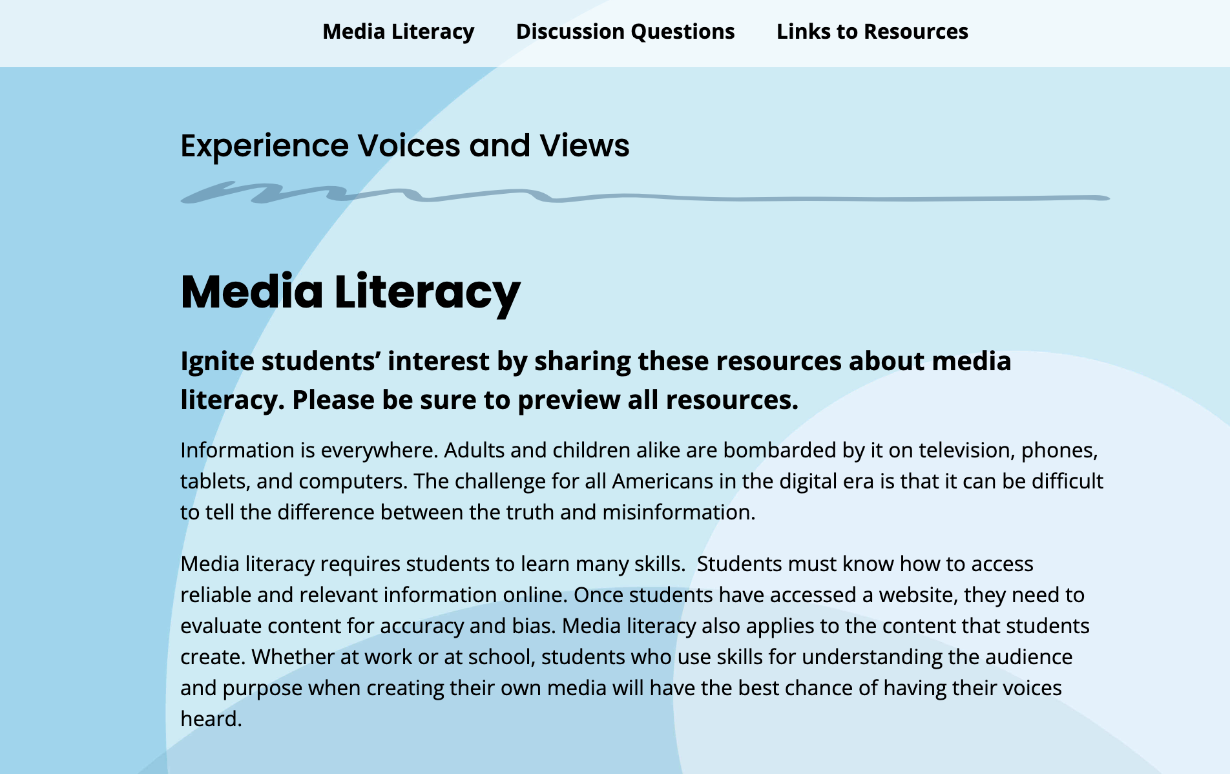
Connect students to content on savvas.com/election
Voices & Views
Media Literacy
Connections to Today
Free Speech in the Digital Age

Slide 5
Skill Video: Find Accurate Information

Slide 6
Reading Passage:
Where do you learn the news?

Slide 7
See-Think-Wonder
Does the book cover match the story?
Notes:
Teacher Notes:
Suggested strategy for classrooms grades K-2
Use familiar book covers to ask students if the cover matches the story (i.e. Campaign for Books, Duck for President, Etc.)
﻿﻿Ask them to look at an image, map, or graph and answer these questions:
What do you see?
What does that make you think?
What are you wondering about now that you've seen this?
﻿﻿Have students share their answers with the class.

Slide 8
Take a Stand
Is the headline real?
Notes:
Teacher Notes:
Suggested strategy for classrooms grades 3-5
Pull headlines from the news and create some of your own.
Ask students to take a stand on a yes-or-no or agree/disagree critical thinking question.
Ask students to divide into two groups based on their answer and move to separate areas of the classroom.
Ask students to talk with each other to compare their reasons for answering yes or no.
Ask a representative from each side to present and defend the group's point of view.

Slide 9
Write 1 - Get 3
How can I tell if information is reliable?
Notes:
Teacher Notes:
Suggested strategy for classrooms grades 6-8
Ask a question with multiple answers, such as: What are four key characteristics of (a dictator)? What are the five key causes of.
﻿﻿Have students write down one response and then go around the room asking for three other responses. If they think a response is correct, ask them to write it down.
﻿﻿Have students keep asking and writing until they have three more responses on their page.
﻿﻿Have students share and discuss responses with the class.

Slide 10
Word Wall
What are some words that might appear in an article that could indicate bias?
Notes:
Teacher Notes:
Suggested strategy for classrooms grades 9-12
﻿﻿Ask students to choose one of the Key Terms for the lesson and create a visual image with a text definition. Allow approximately three to five minutes.
﻿﻿Ask students to post their words on the board or on chart paper and ask students to look at all the various responses.
﻿﻿Discuss similarities and differences in the responses as a group.
﻿﻿Pick a few favorites and post them on the class "Word Wall" for the year.

Slide 11
Civic Skill Instruction
Evaluate Media

Slide 12
Where Do You Learn the News?
OBJECTIVES
Learn more about finding accurate information by evaluating news sources.
Trace changes in the media landscape over time.
Identify the effects of social media on how we learn about current events.
Notes:
Teaching Suggestions
The slides in this presentation walk students through the key elements of the Savvas lesson, with Teaching Suggestion notes available in presenter view. The slides are fully customizable for you to add and/or subtract to make the lesson your own. You can delete slides you know you won’t want to use, mark slides to be skipped so they won’t be seen, or add slides to incorporate your own favorite assets. The teaching suggestions are also fully editable.
The slides that follow each identify which objective is addressed.
Differentiated Instruction
Use these strategies to provide additional support or review for students after they do the Exit Ticket.
Special Needs Prepare slips of paper with the following statements: the first newspapers, radio, television, digital media, social media. After reading, have students sort the slips of paper into the chronological order that the medium was introduced. As they sort, review the audience that was reached by the medium and discuss the impact of the medium.
Extra Support Have partners or small groups work together to come up with pictures to illustrate each of the vocabulary words. Then have partners swap images and guess which is illustrative of which term.
Challenge/Gifted Have students prepare to participate in a discussion about the benefits and challenges of social media in a democratic society. You may point them to decisions made by social media companies such as Twitter or Meta about the limits of free speech on their platforms. You may wish to use a fishbowl or socratic discussion format.

Slide 13
The Evolution of Media
How has the media landscape changed over time?
Newspapers began sharing news in the early 1600s.
Radio could keep up with the speed of news. By the 1920s, many people listened in.
In the early 1900s, theaters screened newsreels for the public.
Television overtook radio in the 1950s to become the main form of home entertainment.
Today many people get their news from digital media.
Notes:
Teaching Suggestions
Learning Objective: Trace changes in the media landscape over time.
Direct students to the Lesson Skills Note-taking Sheet, which they can use as they read the Student Text.
Call on volunteers to share their initial understanding of ways of learning the news.
Discuss the flow chart with students, adding in details about each bubble.
Ask partners to discuss the pros and cons of each news medium.

Slide 14
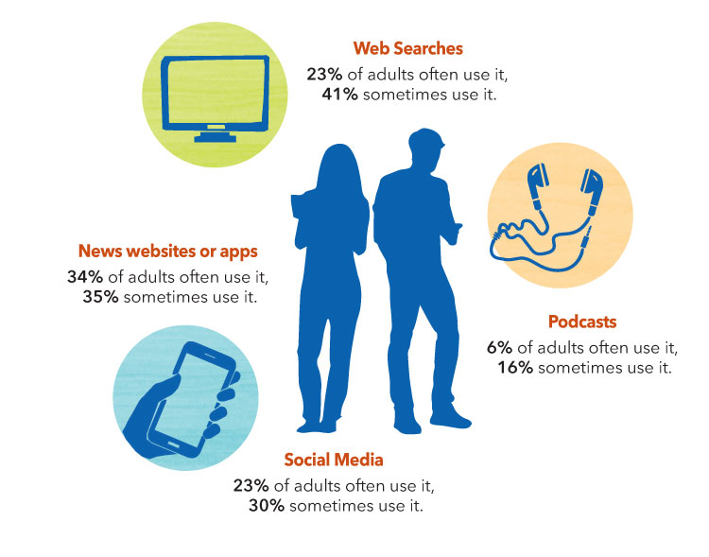
The Impact of Social Media
What are the benefits and drawbacks of social media?
Notes:
Teaching Suggestions
Learning Objective: Identify the effects of social media on how we learn about current events.
Direct student attention to the infographic. Give students time to read and then have them turn and explain to a partner whether anything on the infographic surprised them. Take volunteers to share their answers.
Work together with students to create a list of benefits and drawbacks of social media.

Slide 15
Analyze Quotations
All the nations of the earth would be put upon terms of intimacy and men would be stunned by the tremendous volume of news and information that would ceaselessly pour in upon them.
“Future of Wireless Telegraphy,” New York Times, May 7, 1899
Future of Wireless Telegraphy, New York Times, 1899.
Notes:
Teaching Suggestions
Learning Objective: Trace changes in the media landscape over time.
Remind students that this quotation about the impact of radio on the world was printed in a newspaper in 1899. Read the quotation. Have students take some time to reflect on the differences between life pre- and post- broadcast media.
Ask: Do you agree with the statement? (Students may say no, that compared to today there was not a tremendous volume of news or information, however, the people then may have been stunned.) Could this statement be applied to the present day? (Yes. Today we can access any information we seek in many ways.)

Slide 16
My Favorite Medium
Review the sources posted around the classroom.
Stand by your preferred news source. Be prepared to defend your choice!
Use the Evaluation Guide and share the pros and cons of the news source you selected earlier.
Notes:
Teaching Suggestions
Students reflect on where they hear about current events and get their own information by evaluating news sources. Post the Source Labels around the room, and have each student move to whichever is their main way of hearing what’s happening in the world. Then call on students to explain their choice.
Give each group the Evaluation Guide portion of the Act on It Activity Sheet. Review with students the steps for evaluating news sources.
Identify the author or outlet. Knowing the type of information can help determine the sort of slant the author or outlet may put into the content. This can help determine how critical you should be in your evaluation. How did the source obtain this information? Might this source be biased? Might this source be limited in the amount of information it presents?
What kind of information is being shared? Is it political? Is it a local interest piece? Is it a story? When did the event occur? Are references included?
Why is the information being shared? What motivation does the author or reporter have for sharing this information with you? Does it appear that the author is trying to persuade you of something? Does the source have advertising?
After students have reviewed the evaluation guide, ask them to share the pros and cons of their preferred news source. Ask: Do you think you should expand your news sources? Why or why not?
Pressed for Time? Break the students into groups and assign each group one of the sources. Have students list pros and cons of their assigned source.

Slide 17
Q & A
Answer the following question:
How will I decide what news stories to share?
Notes:
Teaching Suggestions
Do this quick activity with students to see if they’ve understood key ideas in the lesson.
Have students answer the following question on a piece of paper: How will I decide what news stories to share?
Differentiated Instruction
If the Exit Ticket shows that some students still struggle with this lesson, you may want to assign the Lesson Summary as remediation. Give students the Lesson Summary, which is written two levels below grade level, to help students review key concepts

Slide 18
Take Action
Media Checklist
Look at the source.
________________
________________
________________
________________
Notes:
Teaching Suggestions
SKILL: A HEALTHY DOSE OF MEDIA Have students use the skill Evaluate News Sources in the Take Action activity.
Compare the consumption of media to the consumption of food. Many of us love to eat sugary or salty treats, but too much of it is not good for us. Similarly, many of us love to scroll endlessly and get tempted by clickbait. That is not good for us either. As we grow up, we learn how to feed ourselves nutritious food. Well, we also have to learn how to “feed” ourselves healthy information.
Tell students that they will help younger students learn to feed themselves healthy information by making a checklist they can use to evaluate different news sources. Support students in using accessible language to your target grade level.
Work together to create a class checklist that your students can refer to going forward. The first one has been done for you as an example.
Share the checklists with younger students.

Slide 19
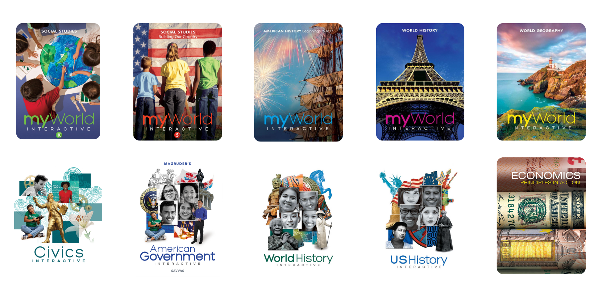
Explore our K-12 Social Studies Curriculum
savvas.com/socialstudies

