Slide 1
If I were President
Lesson #1: Creative Writing

Slide 2
Lesson Resources
1
2
3
4
5
6
Essential Question
Connect
Resources
“If I were President”
Review the lesson objective as you discuss the essential question.
Explore digital resources that support building connections to the content.
Watch the video & use the directions to write your “If I were President” Essays.
Reading Passage:
What is the job of the president?
Active Classroom Strategies
Video & Civic Skill:
Collaborate with Others
Engage with rich civics-centric passages teaching the lesson skill.
Quick strategies to spark conversation, build background knowledge and active student engagement.
Use the video & lesson slides to teach essential civic skills with “Take Action” slides to put the skills to practice.

Slide 3
Essential Question
What would it be like if I were president?

Slide 4
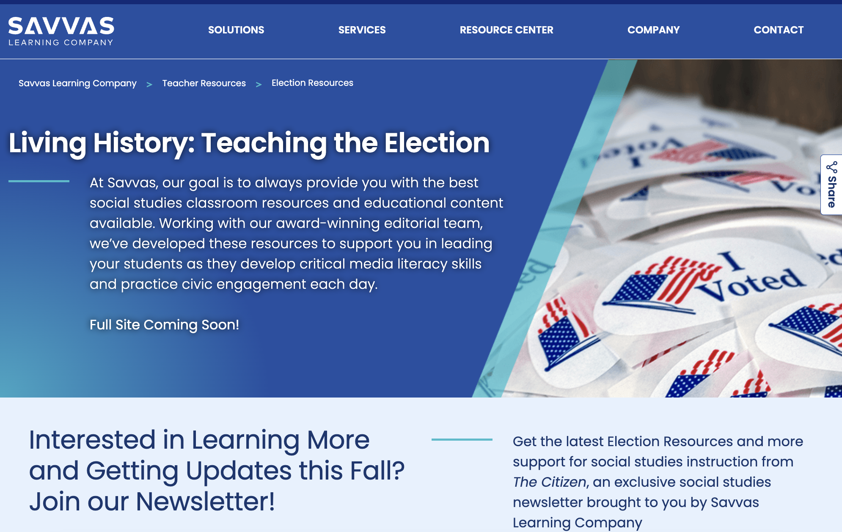
Connect students to content on savvas.com/election
Voices & Views
American Patriotism & Government
Connections to Today
The Role of the President

Slide 5
Reading Passage:
What is the job of the president?

Slide 6
“If I were President” Video

Slide 7
If I Were President
Essay Contest
After the video, brainstorm ideas for your essay
Writing the Essay: Respond to the prompt: "If you were the president, what would you do?"
Need Help? Use the questions below from the video to help you generate ideas!
What does it mean to be president?
What are the characteristics of the president?
What do you think it would be like to live in the White House?
What would you say to the people who voted for you?
What would you want to focus on as president?
Essays can be submitted on savvas.com/election

Slide 8
Sticky Notes
What does a president do? Write your answer on a sticky note!
Notes:
Teacher Notes:
Suggested strategy for classrooms grades K-2
﻿﻿Ask students to spend three minutes jotting down their response to a critical thinking question on a sticky note.
﻿﻿Ask students to work in pairs and share their responses.
﻿﻿Next ask students to post their sticky notes on the board or on chart paper and read all the notes.
﻿﻿Discuss similarities and differences in the responses as a group.

Slide 9
Conversation with History
If you could ask a former president what makes a good leader, who would you ask?
What do you think they would say?
Notes:
Teacher Notes:
Suggested strategy for classrooms grades 3-5
﻿﻿Ask students to choose one of the people mentioned or pictured in the text and write down a question they would like to ask that person if they could.
﻿﻿Next ask students to write what they think that person would say in response and then what they would say in response to that.

Slide 10
Rank It
List the qualities that are important in a president.
Rank the qualities starting with the qualities you find most important.
Notes:
Teacher Notes:
Suggested strategy for 6-8 classrooms
﻿﻿List a group of items/concepts/steps/causes/events on the board.
﻿﻿Ask students to rank the items/steps... according to X criteria (which is most important, which had the greatest impact... most influential, essential, changed, affected).
﻿﻿Ask students to provide a justification for the ranking decisions they made.
﻿﻿Then ask students to work in pairs to share their rankings and justifications.
﻿﻿Poll the class to see if there is agreement on the ranking. OR
﻿﻿Place stickies on the board with key events from the lesson or topic.
﻿﻿Break students into small groups and ask each group to go up and choose the sticky that they think describes the most significant event.
﻿﻿Ask the group to discuss among themselves why they think it is most significant.
﻿﻿Ask one person from each group to explain why the group chose that event.

Slide 11
Walking Tour
What does the passage tell you about the role of the president?
Notes:
Teacher Notes:
Suggested strategy for 9-12 classrooms
Segment Article II into the four sections to be posted around the classroom
Ask small groups to tour the room and discuss each passage.
Summarize each passage as a class.
Alternatively, assign each small group to a passage and have them summarize that passage for the rest of the class.

Slide 12
Skill Video: Collaborate with Others

Slide 13
Civic Skill Instruction
Collaborate with Others

Slide 14
What Is the Job of the President?
OBJECTIVES
Learn ways to work together effectively in groups.
Recognize the many constitutional and traditional roles of the president.
Analyze the power of the presidency and how presidents have tried to expand executive power.
Understand the issue of executive privilege as shown in the case of U.S. v. Nixon.
Notes:
Teaching Suggestions
The slides in this presentation walk students through the key elements of the Savvas lesson, with Teaching Suggestion notes available in presenter view. The slides are fully customizable for you to add and/or subtract to make the lesson your own. You can delete slides you know you won’t want to use, mark slides to be skipped so they won’t be seen or add slides to incorporate your own favorite assets. The teaching suggestions are also fully editable.
This slide presents the learning objectives for the lesson. The slides that follow each identify which objective is addressed.
Differentiated Instruction
Use these strategies to review content with students after they do the Exit Ticket.
Special Needs Ask students to draw pictures illustrating some of the roles of the president.
Extra Support The formal language in the excerpt from the Supreme Court’s decision in United States v. Nixon may present an obstacle to some students. Make sure they understand the meanings of the following words: sustain (support), absolute (total), unqualified (without limits), and immunity (protection), If they still have trouble understanding the gist of the decision, tell them Burger is saying that executive privilege may be necessary sometimes, but that there are limits and the president can’t use it to avoid all legal procedures.
Challenge/Gifted Have students prepare a two-minute podcast about a president of their choosing. Remind them that in two minutes they need to present what they consider the most important facts about that president—their background, their accomplishments, and their failures. Encourage students to pick some of the lesser known presidents, rather than the more obvious choices like Washington, Lincoln, FDR, or Obama.

Slide 15
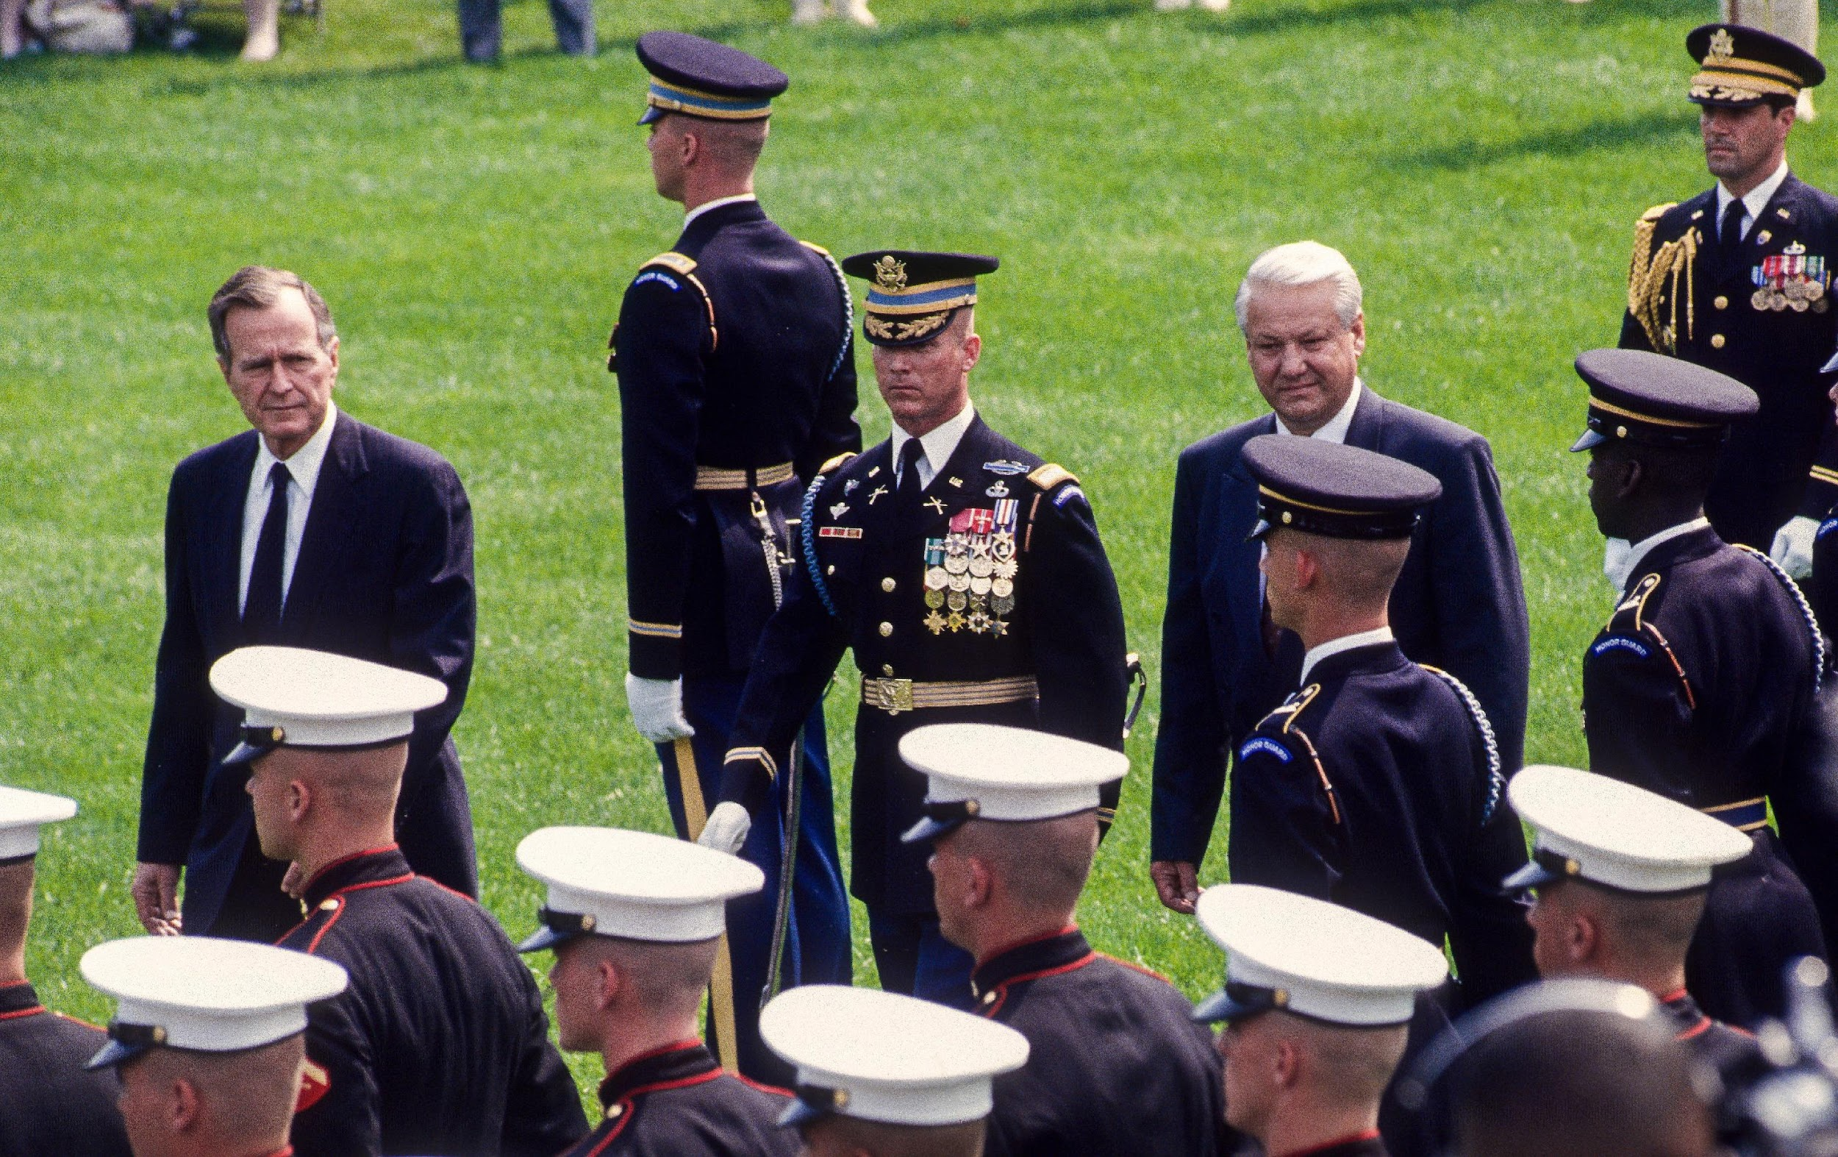
The President Fills Many Roles
Chief Executive – As head of the executive branch, the President must carry out the laws passed by Congress.
Commander-in-Chief – The President sets military goals and approves military tactics.
Mark Reinstein/Alamy Stock Photo
Notes:
Teaching Suggestions
Learning Objective: Recognize the many constitutional and traditional roles of the president.
Direct students to the Lesson Skills Note-taking Sheet, which they can use as they read the Student Text.
Activate prior knowledge by asking students what they know about what the President does. Be sure to correct any misconceptions.
Tell students that the photographs here represent several of the constitutional roles of the President. They show President George H.W Bush reviewing troops; President Ronald Reagan meeting with Indian leader Indira Gandhi; and President Joseph Biden addressing a joint session of Congress.
Ask students, by a show of hands, which role of the President they think is the most important. Have volunteers explain their reasons.
Conclude by telling students that President also have unofficial roles. They are the leaders of their political parties. The President also serves as Head of State, doing things like giving medals and issuing proclamations on national holidays.

Slide 16
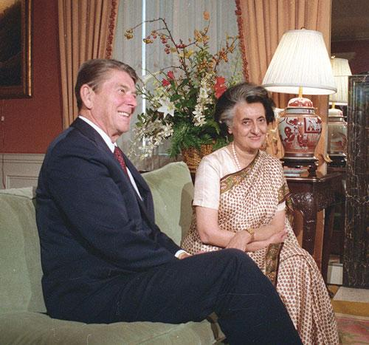
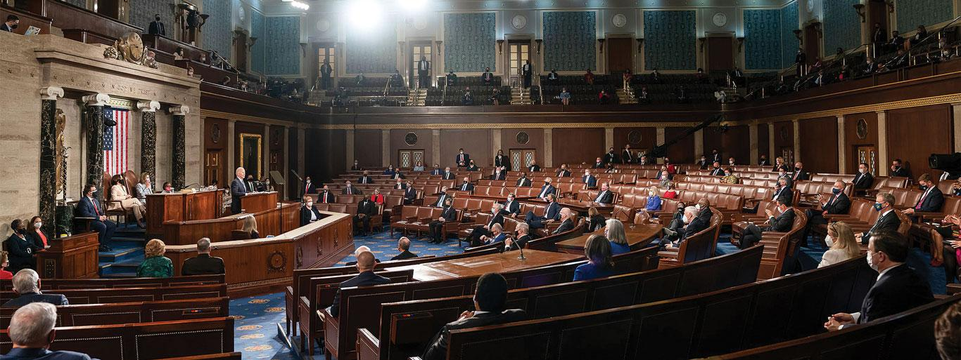
The President Fills Many Roles
Chief Diplomat – The President makes foreign policy and negotiates with foreign leaders.
Legislative Leader– The President sets goals and encourages Congress to pass legislation.
Bettmann/Getty Images; American Photo Archive/Alamy Stock Photo

Slide 17
Analyze Charts
Job Title | Qualifications
President of the United States | Must be a natural-born citizen of the United States Be at least 35 years old Have been a resident of the United States for 14 years
Vice President of the United States | Must be a natural-born citizen of the United States Be at least 35 years old Have been a resident of the United States for 14 years
United States Senator | Live in the state they represent at time of election Be at least 30 years old Have been a citizen of the United States for at least 9 years
United States House Representative | Live in the state they represent at time of election Be at least 25 years old Have been a citizen of the United States for at least 7 years
Notes:
Teaching Suggestions
Learning Objective: Recognize the many constitutional and traditional roles of the president.
Show students the chart listing the constitutional qualifications for president, vice president, senator, and representative.
Ask: Which two offices have identical qualifications? (president and vice president) Why do you think they are the same? (The vice president may have to take over the duties of the president. Therefore, the vice president must have the same qualifications.)
Ask: In what ways do the qualifications for president differ from those for members of Congress? (Naturalized citizens can be elected to Congress, but they cannot serve as president. The age qualifications for each office also differ.)
Ask: What qualification is the same for all the offices shown? (To hold any of these offices, one must be a U.S. citizen.)

Slide 18
Expanding the Power of the Presidency: The Louisiana Purchase
What the President Wanted to Do
Was the President Allowed to Do It?
Result
French emperor Napoleon offered to sell the Louisiana territory to the United States.
President Thomas Jefferson wanted to buy Louisiana, BUT...
The Constitution doesn’t say the President can buy territory.
The Constitution does say the President can make treaties with foreign nations.
Jefferson signed a treaty with France to buy Louisiana.
Congress ratified the treaty.
The Louisiana Purchased doubled the nation’s size.
Did President Jefferson exceed his constitutional authority? What do you think?
Notes:
Teaching Suggestions
Learning Objective: Analyze the power of the presidency and how presidents have tried to expand executive power.
Remind students that the Founders worried about putting too much power in one person’s hands, so they put strict limitations on the president’s powers.
Guide students through the stages of the Louisiana Purchase. Ask students who think Jefferson was justified in buying Louisiana to stand on one side of the room. Ask students who think Jefferson exceeded his authority to stand on the other side of the room.
In turn, ask volunteers from each group to explain their reasons.
Ask: What are the benefits and risks of giving a president the freedom to act independently of Congress? (One benefit is that the president can act quickly in an emergency. One risk is that a president might abuse his constitutional powers.)

Slide 19
Executive Privilege: U.S. v. Nixon
Primary Source
“Neither the doctrine of separation of powers nor the generalized need for confidentiality of high-level communications... can sustain an absolute unqualified presidential privilege of immunity from judicial process under all circumstances. ”
Chief Justice Warren Burger, U.S. v. Nixon
U.S. Reports: United States v. Nixon, 418 U.S. 683 (1974).
Notes:
Teaching Suggestions
Learning Objective: Understand the issue of executive privilege as shown in the case of U.S. v. Nixon.
Give students this background information on the primary source: During the investigation of the Watergate scandal, President Richard Nixon refused to turn over tapes of White House conversations. He claimed executive privilege meant he could keep information from Congress. The case went to the Supreme Court, which ruled against Nixon.
Guide students through the primary source. Ask: What does the Supreme Court ruling say about executive privilege? (Executive privilege has limits. A president can’t use it to avoid all court authority.)
Tell students the end result was that Nixon resigned in order to avoid being impeached by Congress.

Slide 20
Work Together Effectively with Advisers
With a group, take on the roles of the President of the United States and the cabinet.
Follow the directions on the Act on It Sheet as you discuss an issue assigned by your teacher.
Give every person a chance to speak.
Keep a record of the discussion and all decisions made.
Notes:
Teaching Suggestions
Students use the skill of working together effectively to examine the job of the president. Divide the class into teams. Give each group copies of the Act on It Activity Sheet.
Posit a specific current issue for each group. Have the groups simulate a meeting in which they discuss the issue and decide on a plan of action, following these guidelines.
Clearly state the task to be done and how you will be about doing it. Teams work best when every person knows their responsibilities. Decide in advance who will make the final decision: Does one person have final responsibility? Is it to be decided by majority vote? Does any decision have to be unanimous?
Listen respectfully and give every person a chance to speak. Make sure that one person does not monopolize the discussion. Give people who have not spoken a chance to be heard, but do not force them to speak if they are uncomfortable doing so.
Keep a record. You may want to appoint one person to take notes of important points in the discussion. Record all decisions. Repeat them aloud so that every person agrees on what the decision was.

Slide 21
As you review the lesson, write down:
One thing you found Surprising
One thing you found Interesting
One thing you found Troubling
Notes:
Teaching Suggestions
Have students complete a SIT strategy to briefly capture their thinking and understanding.
Differentiated Instruction
If the Exit Ticket shows that some students still struggle with this lesson, you may want to assign the Lesson Summary as remediation.
Give students the Lesson Summary, which is written two levels below grade level, to help students review key concepts.

Slide 22
Take Action
Work together effectively
Tips For Working Together
What To Do | What Not To Do
Notes:
Teaching Suggestions
Distribute the Take Action Sheet.
Tell students that they will build upon how they worked together in the Act on It Activity simulation.
Split students into the same groups they worked with in the Act on It Activity. Tell them that they are no longer taking on the roles of the president and advisers.
Have them discuss how they think their simulation went. Tell them to identify what they think they did well but also what could have been done better.
Ask each group to create a brief online tutorial on tips for working together effectively.
PRESSED FOR TIME? Instead of dividing the class back into groups, ask the class as a whole how they think the activity went.

Slide 23
Explore our K-12 Social Studies Curriculum
savvas.com/socialstudies

